Slide 1

DeepNeuron Training
Introduction to PyTorch

Slide 2
Buddy CHAT!!!
10 minutes to get to know others
Feel free to ask any questions to your buddy
Note: We had to make a few buddy changes. Please contact me about any missing buddies or concerns

Slide 3


Why use PyTorch?
PyTorch provides the fundamental building blocks for NN’s
Just enough to get you going
You get to choose
Exactly how your dataset is used
Your model architecture
What layers are trained
Used widely by researchers around the world
Higher level libraries like PyTorch-Lightning are built on top of it

Slide 4
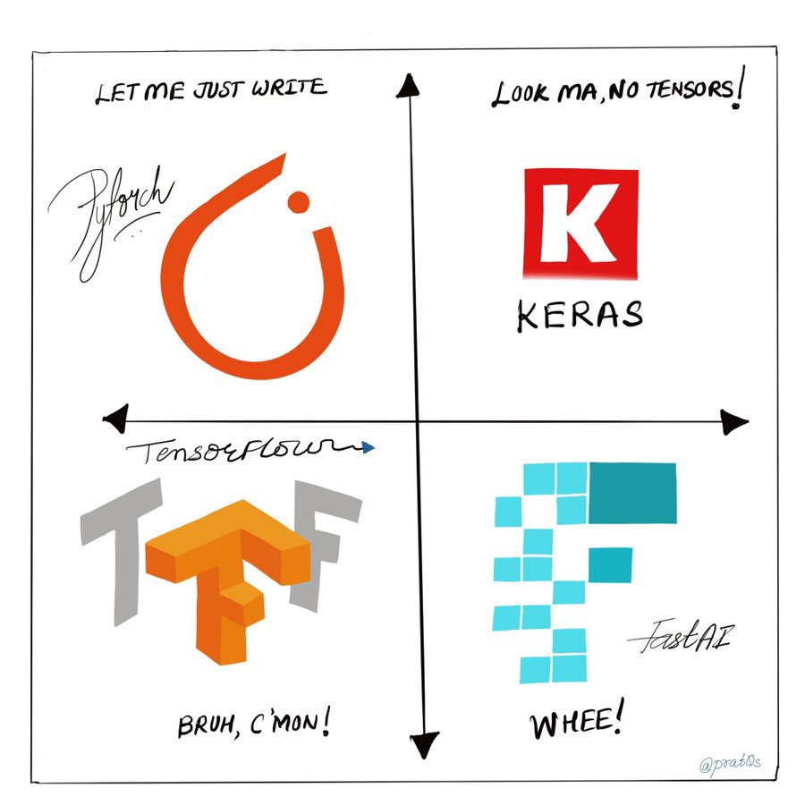
Source: https://towardsdatascience.com/how-pytorch-lets-you-build-and-experiment-with-a-neural-net-de079b25a3e0

Slide 5
Key Ingredients
Dataset
Model
Training
Evaluation
Training and validation set, augmentation
Architecture, transfer learning
Epochs, losses, overfitting, learning rate
Metrics, loss investigation
1
2
3
4

Slide 6
Creating Usable Projects
Create your datasets
Split into training and validation subsections
Decide on the learning rate
With or without a scheduler (dynamically modified the learning rate)
Write the training loop
Gradient descent
Evaluate, rinse and repeat
Use metrics

Slide 7

Source: https://blog.paperspace.com/building-computer-vision-datasets/

Slide 8
Datasets
class CustomDataset(Dataset):
def __init__(self, image_paths):
self.image_paths = image_paths
def __len__(self):
return len(self.image_paths)
def __getitem__(self, indices):
if torch.is_tensor(indices):
indices = indices.tolist()
image_path = self.image_paths[indices]
return io.imread(image_path)
Default doesn’t always cut it
Data loader uses this to pull everything out

Slide 9
The dundre methods
__init__:
Define any necessary variables (i.e. as self)
Runs first
__len__:
Provides the number of data points
__getitem__:
Returns items at specified indices

Slide 10
Yes, You Could’ve
dataset = datasets.ImageFolder(root=".")
What if you needed to do something more complicated though?
Like handle new file types

Slide 11
Transforms
data_transform = transforms.Compose([
transforms.RandomSizedCrop(224),
transforms.RandomHorizontalFlip(),
transforms.ToTensor(),
transforms.Normalize(mean=[0.485, 0.456, 0.406], std=[0.229, 0.224, 0.225])
])
Sometimes we need to alter data:
Flip images
Rotate images
Random crops
Colour changes
Full list here
Note: Transformations often, but not always augment (create more data)

Slide 12
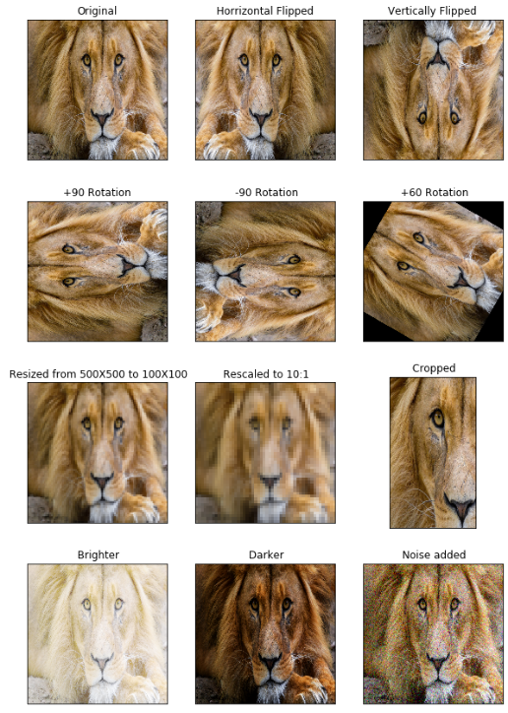
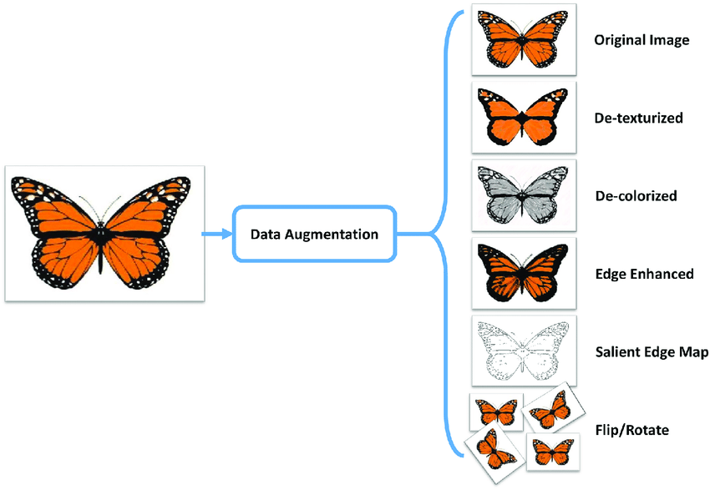
Example Transformations
Source: https://www.mygreatlearning.com/blog/understanding-data-augmentation/, https://medium.com/secure-and-private-ai-writing-challenge/data-augmentation-increases-accuracy-of-your-model-but-how-aa1913468722

Slide 13
Breakout Time - 10 mins
Things you might want to ask about:
What’s the difference between datasets and data loaders?
Where do we define each?
Why do we need transforms?
How do you know what transforms to use?
Which would be most useful?
What transforms do we always use?
Why do we need to normalise our data?

Slide 14
Training Steps
Decide on loss function and optimiser
For every step (training batch):
Predict output (normally label)
Compare prediction to actual answer (loss function)
Improve (back propagate)
Show overall progress each epoch
One dataset at a time
One epoch at a time
One step at a time

Slide 15

Source: https://morioh.com/p/1246b3e0a5cb

Slide 16
Training Decisions
Loss function and optimiser:
Loss function compares prediction to actual truth
To gauge how good/bad a prediction is
Normally Mean Square Error for regression, Cross Entropy Loss for classification
Optimiser defines how to improve based of loss
Normally either Adam (fast) or SGD (accurate)
Metrics:
Provide interpretable measures of how well a model performs
Like accuracy

Slide 17
Sample Step
for _, data in enumerate(train_dataloader, 0):
inputs, labels = data
# Zero the parameter gradients
optimizer.zero_grad()
# Forwards, backwards and optimize
outputs = net(inputs)
loss = criterion(outputs, labels)
loss.backward()
optimizer.step()
For each batch of data
Loop through every epoch

Slide 18
PyTorch Lightning
class SampleModule(pl.LightningModule):
def __init__(self, **kargs):
...
def configure_optimizers(self):
...
def forward(self, x):
...
def training_step(self, batch, batch_idx):
...
def validation_step(self, batch, batch_idx):
...
trainer = pl.Trainer()
trainer.fit(SampleModule())
You don’t have to handle everything yourself

Slide 19
Modified Examples
Look at official PyTorch and PyTorch Lightning docs for further info:
https://pytorch.org/tutorials/beginner/data_loading_tutorial.html
https://pytorch.org/docs/stable/torchvision/transforms.html
https://pytorch.org/tutorials/beginner/blitz/cifar10_tutorial.html#sphx-glr-beginner-blitz-cifar10-tutorial-py
https://pytorch-lightning.readthedocs.io

Slide 20

Source: https://medium.com/@erwinalberto/automate-your-documentation-with-your-ci-cd-pipeline-documentation-as-code-f921acbc5184

Slide 21

Practical Tasks
Go through PyTorch Lightning notebook
Try to convert classical PyTorch code to Lightning
Work with your buddy!
If you can’t complete in time that’s fine (it’s difficult stuff)
We’re running a helpdesk soon (details will be released on Slack)
Source: https://www.olioapps.com/blog/legacy-code/

Slide 22
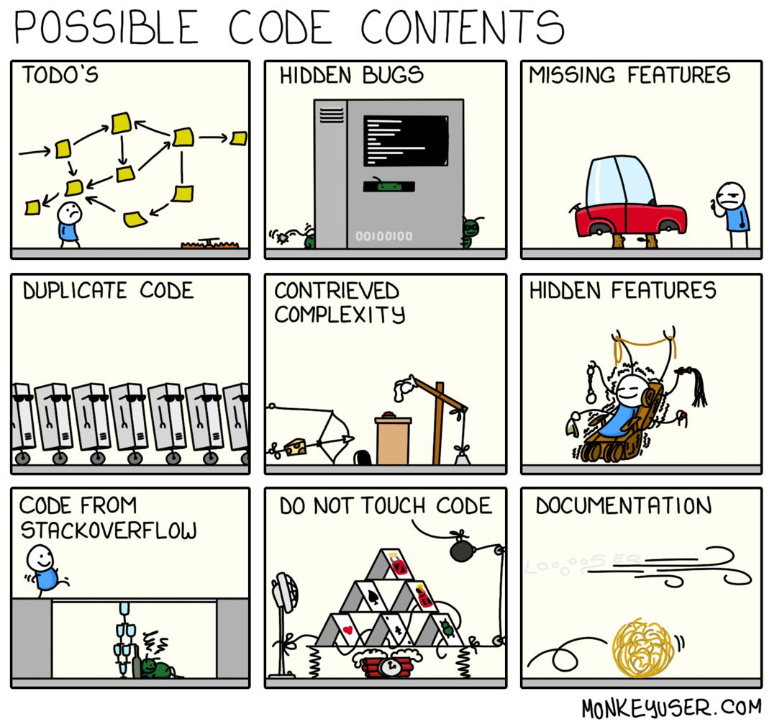
Source: https://fi.pinterest.com/pin/383228249541656993/

Slide 23
Thank you for listening!

